Slide 1

Jimmy Bogard
Crafting Wicked Domain Models

Slide 2

CodeStock is proudly partnered with:
RecruitWise and Staff with Excellence - www.recruitwise.jobs
Send instant feedback on this session via Twitter:
Send a direct message with the room number to @CodeStock
d codestock 503 This session is great!
For more information on sending feedback using Twitter while at CodeStock, please see the “CodeStock README” in your CodeStock guide.

Slide 3













The Hardest Problems
Solved By the Best Engineers
CADRE5

Slide 4
What is a domain model?
Notes:
From PoEAA: An object model of the domain that incorporates both behavior and data.
Key – data AND behavior
Beyond nouns and verbs

Slide 5
Why should I care?
Notes:
A lot of times – you shouldn’t
When you should – complex domain, or a long-lived project where behavior gets added piece by piece

Slide 6
Good news
Notes:
We can delay the decision and design until it’s needed

Slide 7
Current State

Slide 8
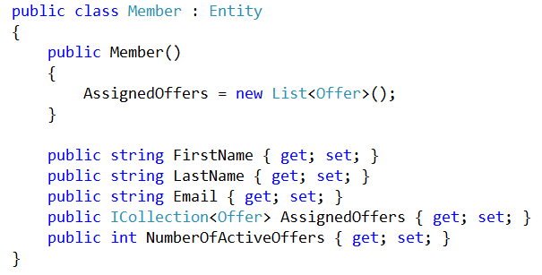
Notes:
Loyalty program
Looks rich, right?

Slide 9
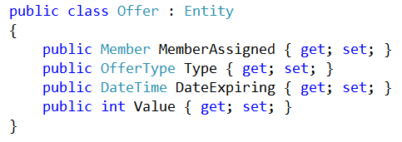
Notes:
Loyalty program
Looks rich, right?

Slide 10
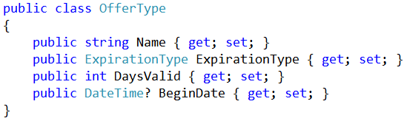
Notes:
Loyalty program
Looks rich, right?

Slide 11
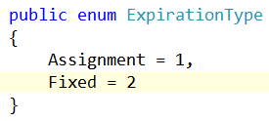
Notes:
Loyalty program
Looks rich, right?

Slide 12
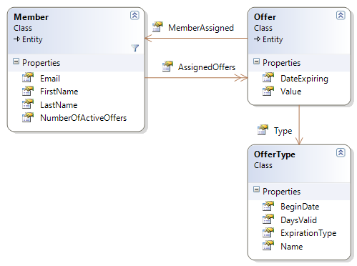
Notes:
Loyalty program
Looks rich, right?

Slide 13
Where’s the behavior?

Slide 14
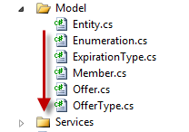

Slide 15
Anemic domain models
Notes:
The basic symptom of an Anemic Domain Model is that at first blush it looks like the real thing. There are objects, many named after the nouns in the domain space, and these objects are connected with the rich relationships and structure that true domain models have. The catch comes when you look at the behavior, and you realize that there is hardly any behavior on these objects, making them little more than bags of getters and setters. Indeed often these models come with design rules that say that you are not to put any domain logic in the the domain objects. Instead there are a set of service objects which capture all the domain logic. These services live on top of the domain model and use the domain model for data.

Slide 16
Pop the hood

Slide 17
Offer Assignment Service

Slide 18
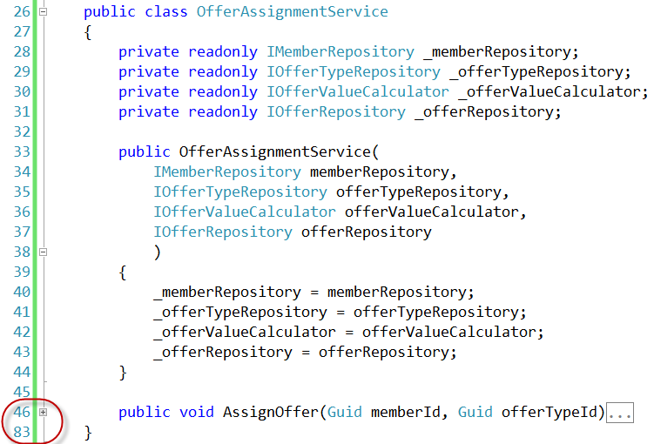

Slide 19
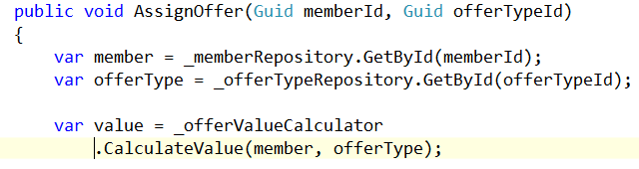

Slide 20
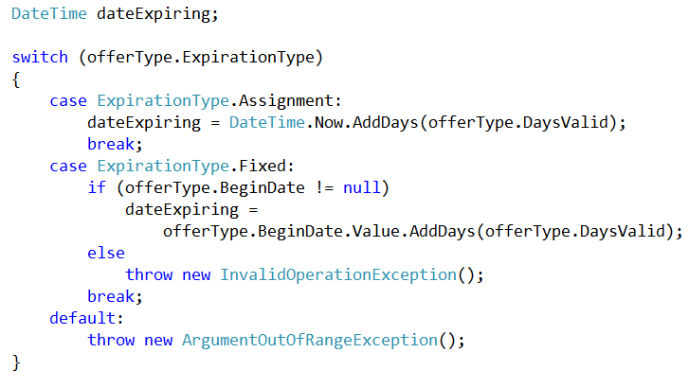

Slide 21
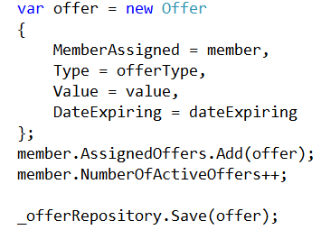

Slide 22
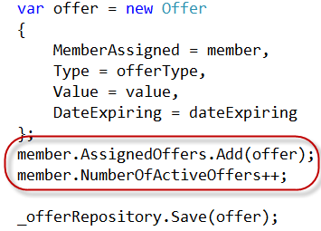

Slide 23
Behavior is there…

Slide 24
…but in the wrong place!

Slide 25
Solution
Notes:
Paying attention to code smells, model smells, OO and refactoring

